Slide 1
Chapter Topics
Binary Trees and Their Applications
Binary Search Trees

Slide 2
Binary Trees
A binary tree is like a linked list, except each node may have up to two successors.
A successor of a node X in a binary tree is called a child of X.
In a binary tree, each node has at most one predecessor. The predecessor of X is called the parent of X.
A child of a node in a binary tree is either a left child or a right child.

Slide 3
Facts About Binary Trees
If a node C is a child of another node P, then P is called the parent of C.
A binary tree may be empty.
A nonempty binary tree has a unique node that has no parent. This node is called the root of the binary tree.
A node with no children is called a leaf.

Slide 4
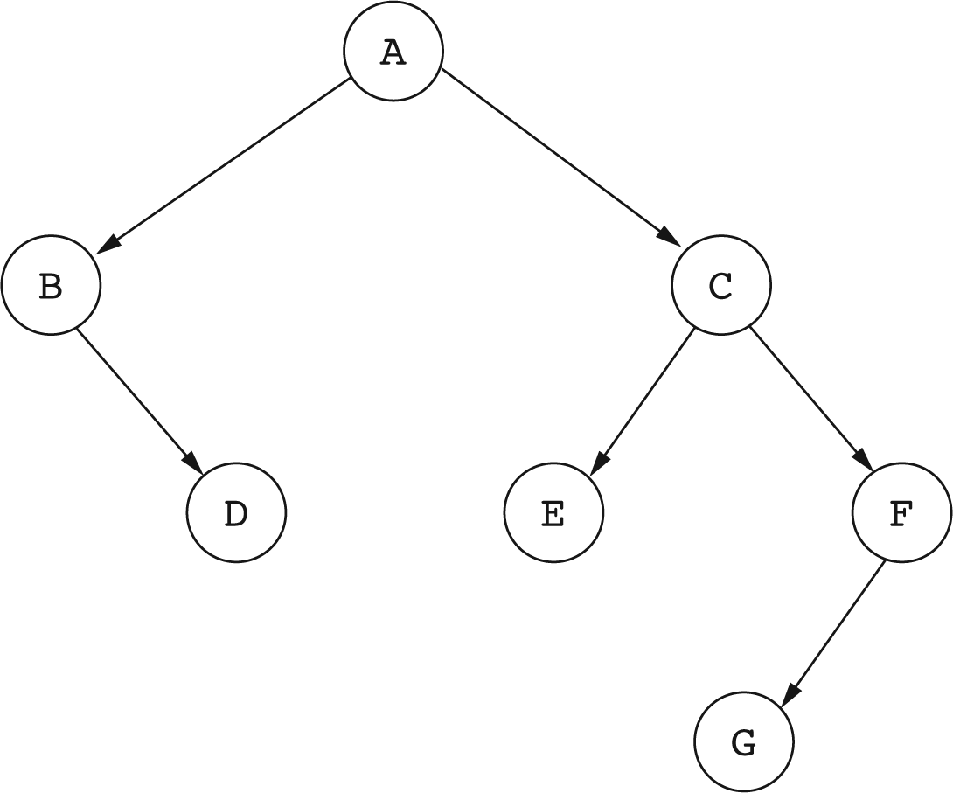
A Binary Tree
C is the right child of A.
E is the left child of C.
D and G are leaves.
A is the root.

Slide 5
Additional Terminology
Let X be a node in a binary tree T. A node Y is a descendant of X if Y is on the path from X to a leaf of T.

Slide 6
Descendants of a Node
Descendants of C are C, E, F, and G.
Descendants of B are B and D.

Slide 7
Subtrees
The collection of all descendants of a node X forms a binary tree, called the subtree of T rooted at X.
If R is the root of T, then the subtree rooted at the left child of R is called the left subtree of T, and the subtree rooted at the right child of R is called the right subtree of T.

Slide 8
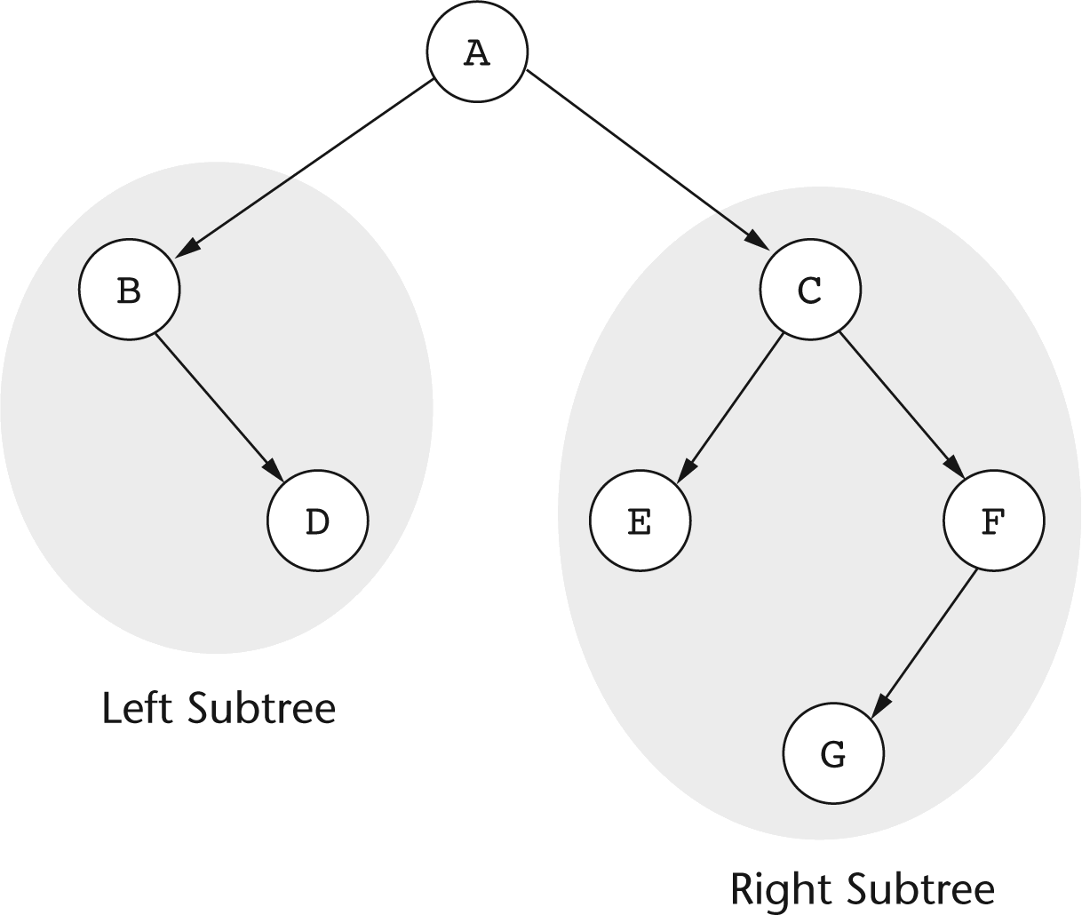
Subtrees of a Binary Tree

Slide 9
Applications of Binary Trees
Binary trees are used to organize information to support fast search.
Generalizations of binary trees are used in database systems to store data.

Slide 10
Implementation of Binary Trees
Implementation is based on a Node class similar to what is used in linked lists.
class Node
{
String element;
Node left; // Left child
Node right; // Right child
Node(String e, Node left, Node right)
{
element = e;
this.left = left;
this.right = right;
}
}

Slide 11
Representing a Binary Tree
A binary tree is represented by a reference to its root node.
Node myTree;
An empty binary tree is represented with a reference whose value is null.

Slide 12
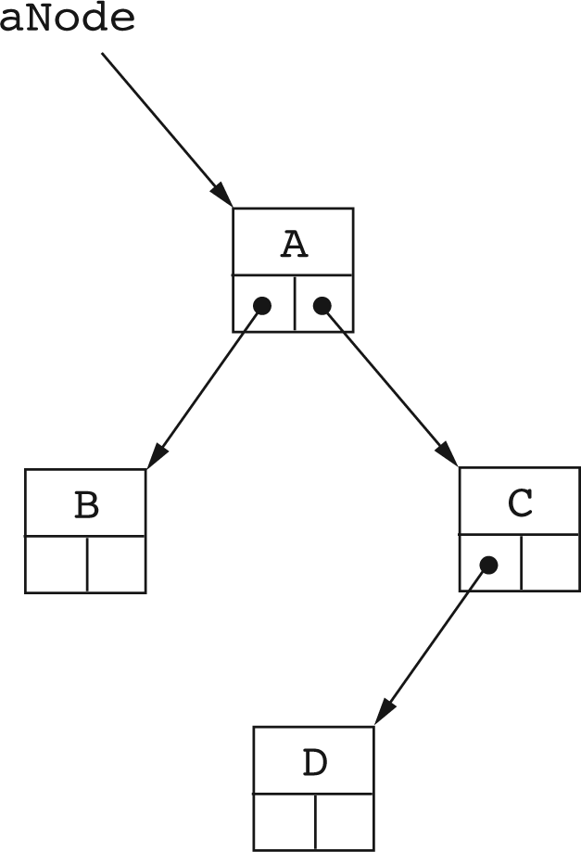
Using the Node Class to Build Binary Trees.
dNode = new Node(‘D’, null, null);
cNode = new Node(‘C’, dNode, null);
bNode = new Node(‘B’, null, null);
aNode = new Node(‘A’, bNode, cNode);

Slide 13
A Class For Representing Binary Trees
public class BinaryTree
{
private class Node
{
int element; // Value stored in node
Node left, right; // Left and right child
Node(int val)
{
element = val;
left = null; right = null;
}
Node(int val, Node leftChild, Node rightChild)
{
element = val;
left = leftChild; right = rightChild;
}
}
Node root = null; // Root of the binary tree
}

Slide 14
Recursive Nature of Binary Trees
The concept of a binary tree has a natural recursive definition:
A binary tree is a collection of nodes that is either empty (base case), or consists of a root node, with the rest of the nodes being divided into two collections that are also binary trees (the left and right subtrees)

Slide 15
Traversal of Binary Trees
A traversal of a binary tree is a systematic method of visiting each node in the binary tree.
There are three binary tree traversal techniques:
  Preorder traversal
  Inorder traversal
  Postorder traversal

Slide 16
Binary Tree Traversal
All three traversal techniques are recursive:
a nonempty binary tree is traversed by visiting the root and then recursively traversing the left and right subtrees.

Slide 17
Preorder Traversal
Preorder traversal visits the root first, and then recursively traverses the left and right subtrees.
void preorder(Node tree)
{
if (tree != null)
{
System.out.print(tree.element + “ “); // root first
preorder(tree.left);
preorder(tree.right);
}
}

Slide 18
Inorder Traversal
Inorder traversal recursively traverses the left subtree, then visits the root, and then traverses the right subtree.
void inorder(Node tree)
{
if (tree != null)
{
inorder(tree.left);
System.out.print(tree.element + “ “); // root IN between
inorder(tree.right);
}
}

Slide 19
Postorder Traversal
Postorder traversal recursively traverses the left and right subtrees, and then visits the root.
void postorder(Node tree)
{
if (tree != null)
{
postorder(tree.left);
postorder(tree.right);
System.out.print(tree.element + “ “); // root last
}
}

Slide 20
Binary Search Trees
Binary search trees are binary trees that organize their nodes to allow a form of binary search.
Binary search trees work with values such as strings or numbers, that can be sorted.
The idea is to store values in nodes so that small values are stored in the left subtree, and larger values are stored in the right subtree.

Slide 21
Binary Search Trees
A binary search tree is a binary tree that stores nodes in such a way that at each node X,
  Every value stored in the left subtree of X is less than the value stored at X.
  Every value stored in the right subtree of X is greater than the value stored at X.

Slide 22
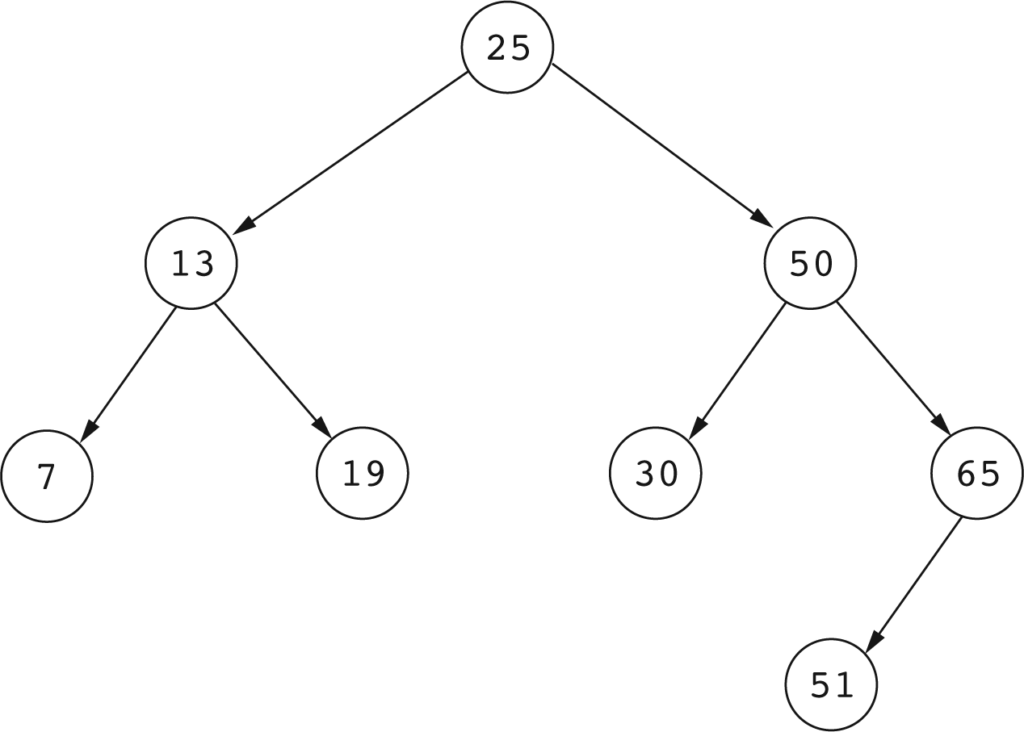
Example of a Binary Search Tree

Slide 23
Adding Values to Binary Search Trees
The strategy for adding X to a binary search tree is recursive:
  Base case: if the tree is empty, create and return a tree with a single node containing X.
  Non base case: Compare X to the value in the root.
    If X is less, recursively add X to the left subtree.
    If X is greater, recursively add X to the right subtree.
    Return the resulting tree.

Slide 24
Adding a Value to a Binary Search Tree
private Node add(int x, Node bstree)
{
if (bstree == null) return new Node(x);
// bstree is not null.
if (x < bstree.element)
{
// Add x to the left subtree and replace the
// current left subtree with the result
bstree.left = add(x, bstree.left);
}
else
{
// Add x to the right subtree
bstree.right = add(x, bstree.right);
}
return bstree;
}

Slide 25
Add: The Public Interface
The public add method calls the private add method on the root of the search tree:
public boolean add(int x)
{
root = add(x, root);
return true;
}

Slide 26
Checking for the Presence of a Value
The strategy for checking if a binary search tree contains a value X is recursive:
Base case: if the tree is empty, return false.
Non base case: Compare X to the value stored in the root:
  If X equals the value in the root, return true.
  If X is less, recursively check if the left subtree contains X.
  If X is greater, recursively check if the right subtree contains X.

Slide 27
Checking if a Tree Contains X
private boolean contains(int x, Node bstree)
{
if (bstree == null)
return false;
if (x == bstree.element)
return true;
if (x < bstree.element)
{
// Recursively look in left subtree
return contains(x, bstree.left);
}
else
{
// Recursively look in right subtree
return contains(x, bstree.right);
}
}

Slide 28
Contains: The Public Interface
The public contains method calls the private contains method on the root of the binary search tree:
public boolean contains(int x)
{
// Call the private recursive method
return contains(x, root);
}

Slide 29
Removing Elements From Binary Search Trees

Slide 30
Removing Elements
To remove a leaf node, just delete the node: That is, replace it with null.
To remove a node with one child, replace the node with its one child.

Slide 31
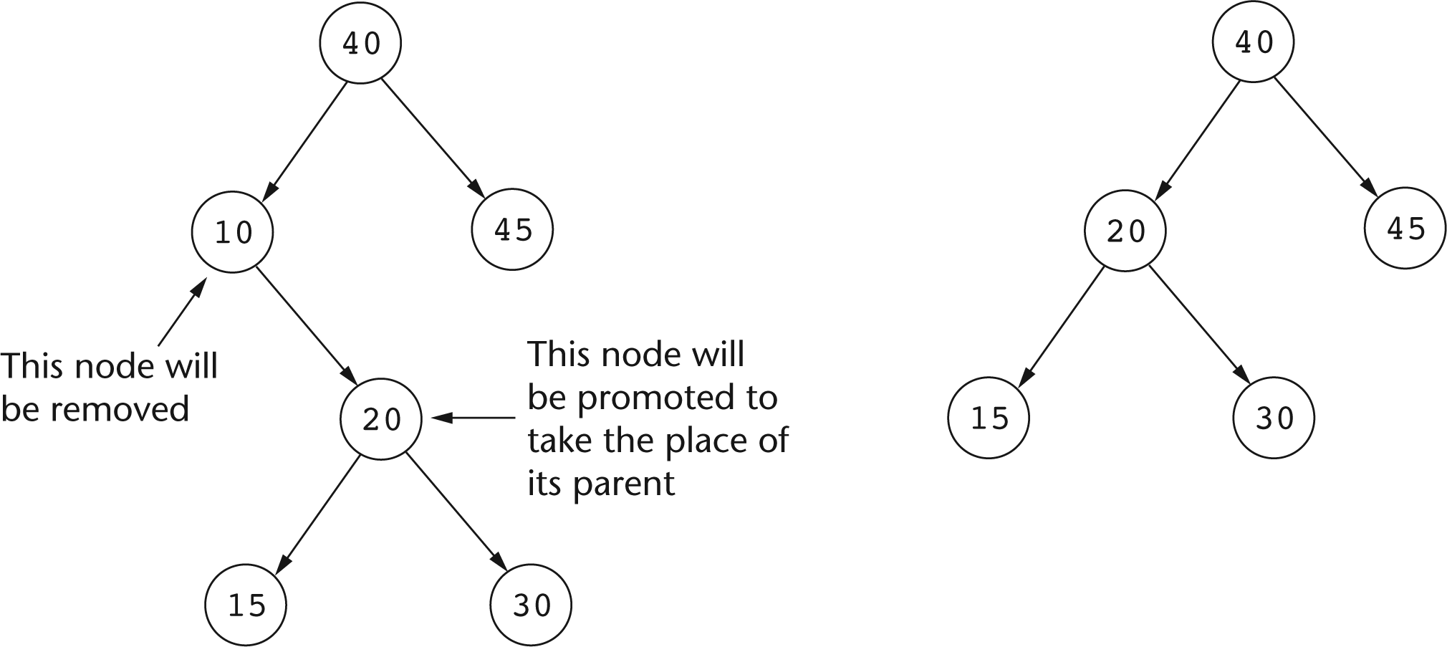
Before and After Removing a Node With One Child.

Slide 32
Removing a Node
To remove a node with 2 children, the subtrees of the deleted node need to be combined into a single tree that takes the place of the deleted node.
This is done by removing the greatest node in the left subtree and using it to replace the removed node.

Slide 33
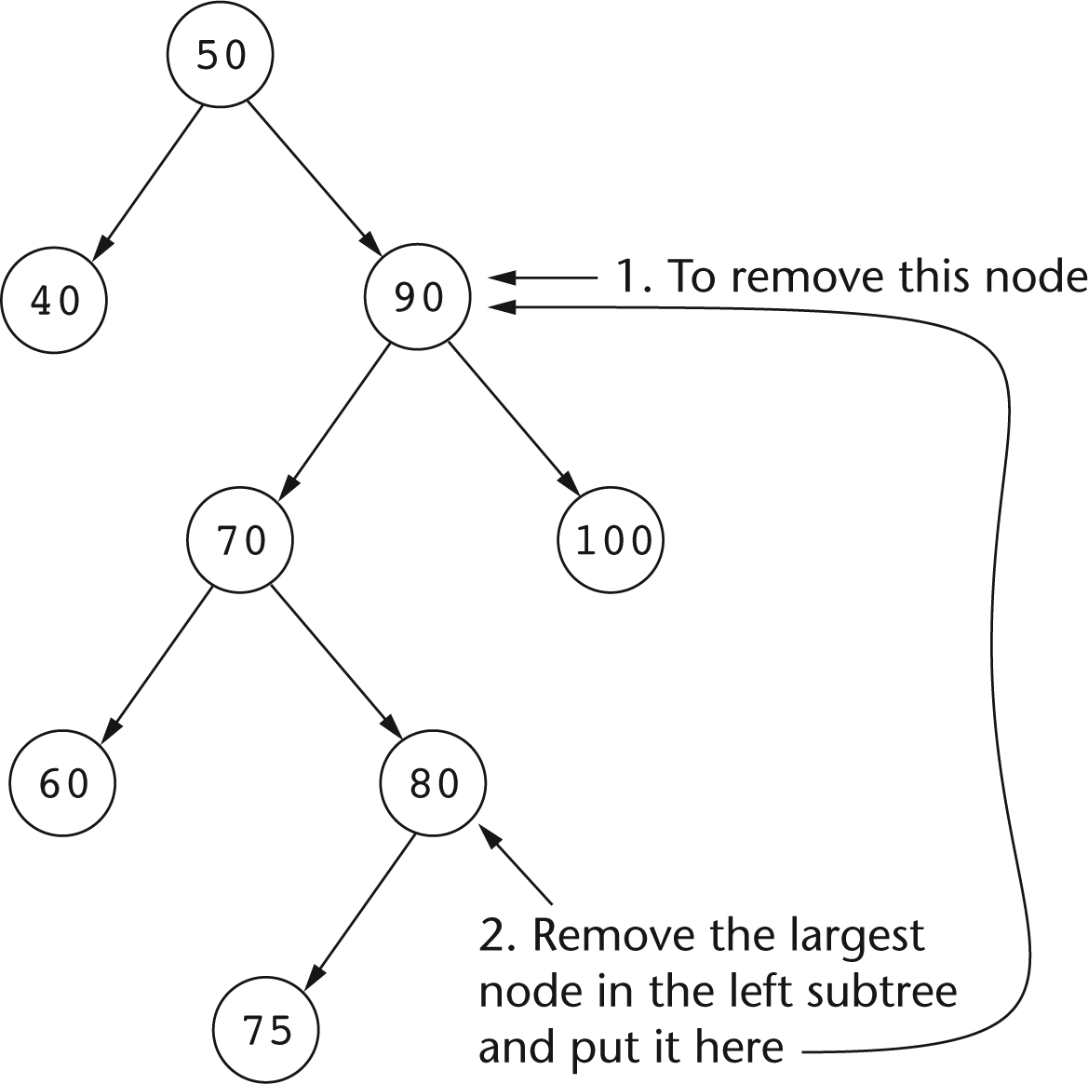
Removing a node with 2 Children

Slide 34
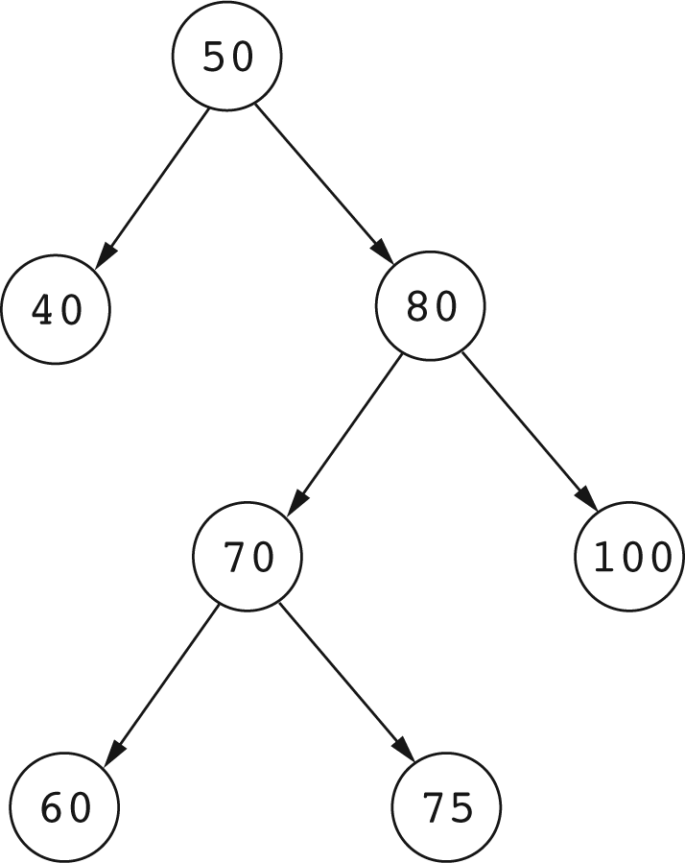
The Tree of Last Slide After Removing 90

Slide 35
Removing X From a Search Tree
Removing a value X from a binary search tree returns a RemovalResult object:
class RemovalResult
{
Node node;
Node tree;
RemovalResult(Node n, Node t)
{
node = n; tree = t;
}
}
node is the node that contains X, unhooked from the search tree.
tree is the tree that remains after removing the node containing X.

Slide 36
Removing X from a Binary Search Tree
If X is the root, remove it.
Otherwise compare X to the value in the root:
  If X is less, recursively remove X from the left subtree.
  If X is greater, recursively remove X from the right subtree.
Removing X from a binary search tree boils down to removing the root of some subtree of the binary search tree.

Slide 37
Removing roots of Subtrees
Suppose that the method
RemovalResult remove(Node bTree, int x)
finds x in the root of the subtree bTree.
If the root (bTree) has no children, the method returns
  new RemovalResult(bTree, null)
  This means that the root node has been removed,
  and the remaining tree is empty.

Slide 38
If
RemovalResult remove(Node bTree, int x)
finds a root node that has one child, then the root node (bTree) is the removed node, and the remaining tree is the one subtree of the root:
Node node = bTree; // Removed node
Node tree; // Remaining tree
// Remaining tree is the one nonempty subtree
if (bTree.left != null)
tree = bTree.left;
else
tree = bTree.right;
node.left = null;
node.right = null;
return new RemovalResult(node, tree);

Slide 39
Removing a Root with 2 children
When removing a root node that has two children: deleting the root leaves two children, which somehow must be combined into one tree.
We can combine the two subtrees into one by removing the greatest node in the left subtree and making it the root of the remaining tree.

Slide 40
RemovalResult remove(Node bTree, int x)
To remove a root Node with 2 children:
// Remove largest node in left subtree and
// make it the root of the remaining tree
RemovalResult remResult = removeLargest(bTree.left);
Node newRoot = remResult.node;
// Use the remaining tree from the left subtree
newRoot.left = remResult.tree;
newRoot.right = bTree.right;
// Prepare the result to be returned
bTree.left = null;
bTree.right = null;
return new RemovalResult(bTree, newRoot);

Slide 41
Removing the Largest Node
Removing the largest node in a binary search tree is part of the procedure for removing a root node with two children.
In a binary search tree T, the largest node is the root if T has no right subtree, otherwise it is the largest node in the right subtree of T.
The largest node can be removed with a natural recursive strategy.

Slide 42
Removing the Largest Node
RemovalResult removeLargest(Node bTree)
{
if (bTree == null) return null;
if (bTree.right == null)
{
// Root is the largest node
Node tree = bTree.left;
bTree.left = null;
return new RemovalResult(bTree, tree);
}
else
{
// Remove the largest node from the right subtree
RemovalResult remResult = removeLargest(bTree.right);
bTree.right = remResult.tree;
remResult.tree = bTree;
return remResult;
}
}
}

Slide 43
Remove: The public Interface
The public interface calls the private remove on the root of the binary search tree:
public boolean remove(int x)
{
RemovalResult result = remove(root, x);
if (result == null)
return false;
else
{
root = result.tree;
return true;
}
}

